Slide 1
Spring Framework 6 and Spring Boot 3 for Beginners (Includes Simple Projects)
Ramesh Fadatare ( Java Guides)

Slide 2















Learn Spring Core
Spring IoC Container
Java based configuration
Spring Core
Annotation based configuration
Dependency Injection
Spring beans Spring Core annotations
Ramesh Fadatare ( Java Guides)

Slide 3








Learn Spring Boot
Building Spring Boot REST APIs
Spring Boot CRUD REST APIs Using DTO Pattern
Spring Boot
Using Mapping Libraries
Exception Handling
Validations Spring Boot Actuator
Transaction Management
Ramesh Fadatare ( Java Guides)

Slide 4





Learn Spring Data JPA
Spring Data JPA Basics
Steps to Use Spring Data JPA in Spring Boot App
Spring Data JPA
Spring Data JPA Important Methods
Spring Data JPA Query Methods More (adding more content)
Ramesh Fadatare ( Java Guides)

Slide 5

















What is Spring Boot?
The main goal of Spring Boot is to quickly create Spring-based applications without requiring developers to write the same boilerplate configuration again and again.
Spring Boot Starters
Spring Boot auto-configuration
Spring Boot
Externalized Configuration
Spring Boot Actuator
Spring Framework
Easy-to-use embedded servlet container support

Slide 6
Spring Framework
Spring is a very popular Java framework for building web and enterprise applications.
Spring is very popular for several reasons:
dependency injection
Easy to use but powerful database transaction management capabilities
Good Integration with other Java frameworks like JPA/Hibernate ORM, Struts/JSF/etc. web frameworks
- Web MVC framework for building web applications
Ramesh Fadatare ( Java Guides)

Slide 7
What is a Problem?
Basically, Spring-based applications have a lot of configurations. For example:
When we develop Spring MVC web application using Spring MVC then we need to configure:
Component scan, Dispatcher Servlet, View resolver, Web jars(for delivering static content) among other things.
When we use Hibernate/JPA in the same Spring MVC application then we would need to configure a
Data source, Entity manager factory/session factory, Transaction manager among other things.
When you use cache, message queue, NoSQL in the same Spring MVC application then we need to configure:
Cache configuration
Message queue configuration NoSQL database configuration
One more major problem - We need to maintain all integration of different Jar dependencies and it’s
compatible versions
Ramesh Fadatare ( Java Guides)

Slide 8
What is a Solution
Spring Boot is the solution
Spring Boot automatically configures the configurations based on the jar dependencies that we add to our project.
Ramesh Fadatare ( Java Guides)

Slide 9
Create Your First Spring Boot App
By Ramesh Fadatare (Java Guides)

Slide 10
Understanding Spring Boot App Structure
(Important files and folders)
By Ramesh Fadatare (Java Guides)

Slide 11
Spring Boot Starters Feature
By Ramesh Fadatare (Java Guides)

Slide 12

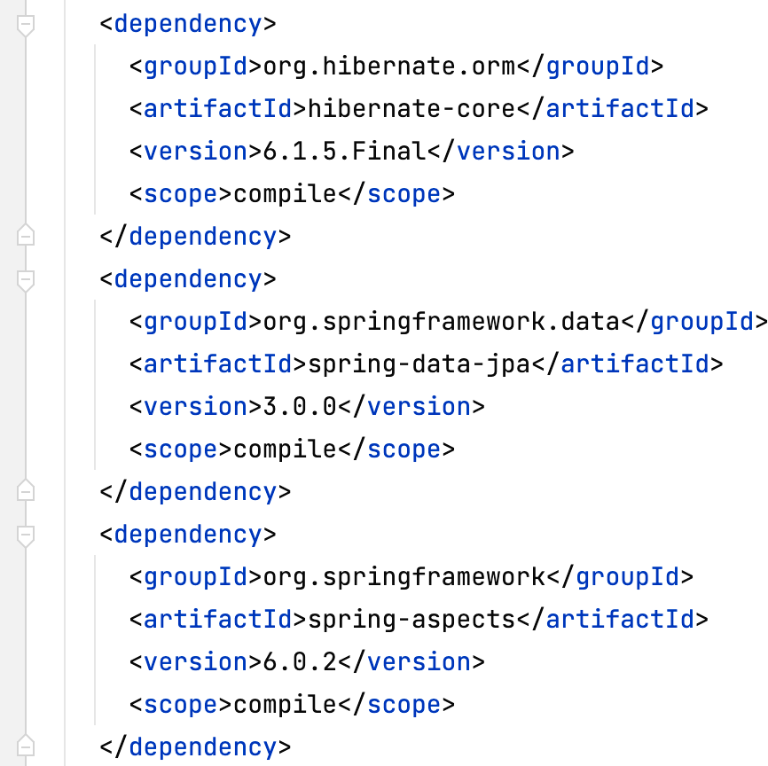





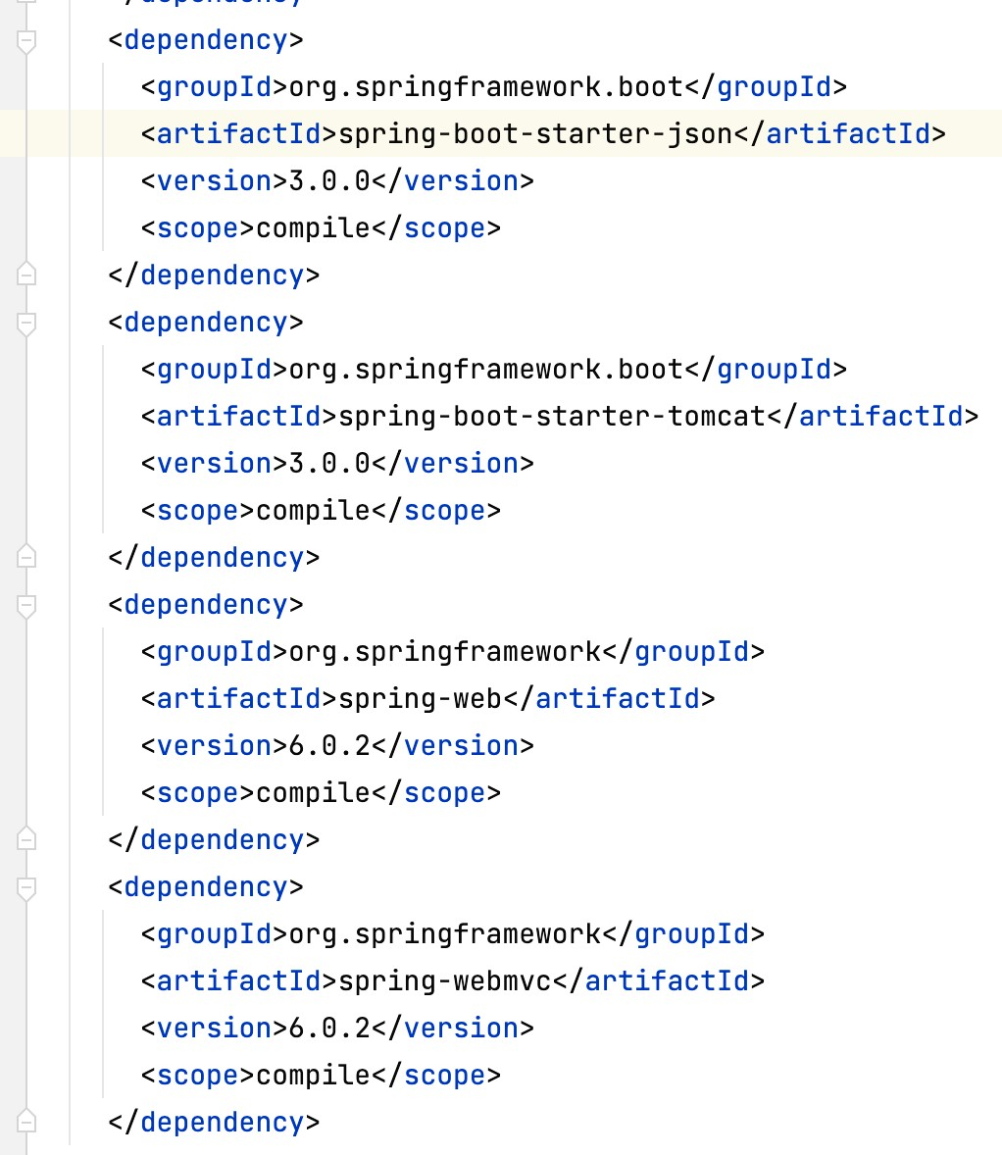



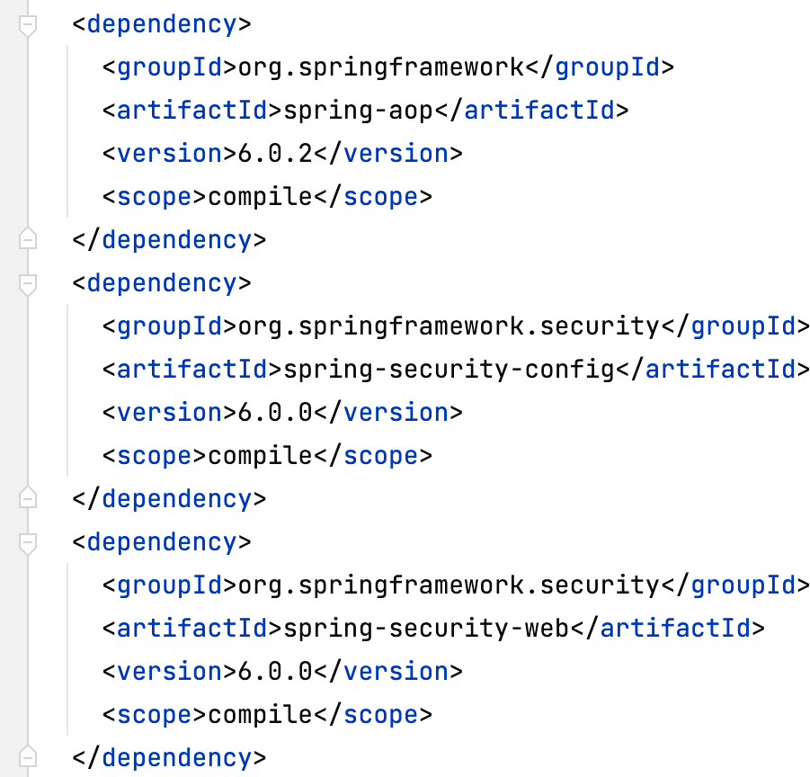
Problem
Spring MVC
Hibernate
Spring Security

Slide 13




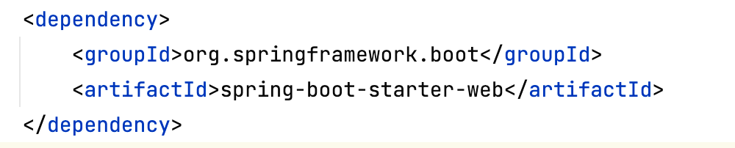

Solution - spring-boot-starter-web
Spring MVC
Spring Boot Web Starter

Slide 14







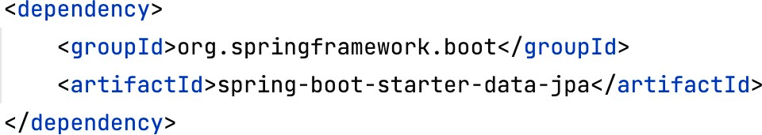

Solution - spring-boot-starter-data-jpa
Spring Data JPA with Hibernate
Spring Boot Starter JPA

Slide 15







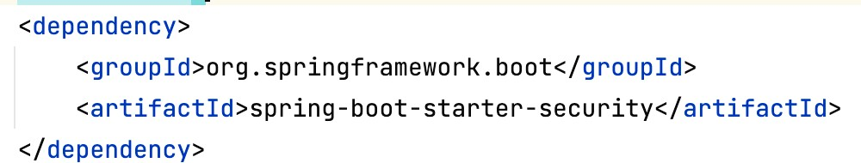

Solution - spring-boot-starter-security
Spring Security
Spring Boot Starter Spring Security

Slide 16
Spring Boot Starters
These starters are pre-configured with the most commonly used library dependencies so you don’t have to search for the compatible library versions and configure them manually.
For example, when we add the spring-boot-starter-web dependency, it will by default pull all the commonly used libraries while developing Spring MVC applications, such as spring- webmvc, jackson-json, validation-api, and tomcat.
One more example, the spring-boot-starter-data-jpa starter module includes all the dependencies required to use Spring Data JPA, along with Hibernate library dependencies, as Hibernate is the most commonly used JPA implementation.
Not only does the spring-boot-start-web add all these libraries but it also configures the commonly registered bean like DispatcherServlet, ResourceHandle, MessageSource, etc. with sensible defaults
Ramesh Fadatare ( Java Guides)

Slide 17
Spring Boot Starter Parent
By Ramesh Fadatare (Java Guides)

Slide 18
Spring Boot Starter Parent
The spring-boot-starter-parent project is a special starter project that provides:
Default configurations
Manage the versions of dependencies
Default configurations for Maven plugins
Ramesh Fadatare ( Java Guides)

Slide 19
Spring Boot Auto Configuration Feature
By Ramesh Fadatare (Java Guides)

Slide 20
Problem
Basically, Spring-based applications have a lot of configurations.
For example:
When we develop Spring MVC web application using Spring MVC then we need to configure:
Component scan, Dispatcher Servlet, View resolver, Web jars(for delivering static content) among other things.
When we use Hibernate/JPA in the same Spring MVC application then we would need to configure a
Data source, Entity manager factory/session factory, Transaction manager among a host of other things.
Ramesh Fadatare ( Java Guides)

Slide 21
Solution
When we add Spring MVC Jar dependency to our application then can we automatically configure some Spring beans related to Spring MVC.
Ex: Dispatcher Servlet, View resolver
When we add Hibernate Jar dependency to our application then can we automatically configure Spring beans related to Hibernate.
Ex: Data source, Entity manager factory/session factory, Transaction manager
Ramesh Fadatare ( Java Guides)

Slide 22
Spring Boot Auto Configuration
Spring Boot auto-configuration attempts to automatically configure Spring application based on the jar dependencies that you have added to project.
Example 1: if you add spring-boot-starter-web Jar dependency to your Spring boot application, Spring Boot assumes you are trying to build a SpringMVC-based web application and automatically tries to register Spring beans such as DispatcherServlet, ViewResolver if it is not already registered.
Example 3: If you add spring-boot-starter-data-jpa starter dependency then it assume that you are trying to use Hibernate to develop DAO layer so Spring boot automatically register the Spring beans such as Data source, Entity manager factory/ session factory, Transaction manager.
Spring Boot auto-configuration attempts to automatically configure Spring application based on the jar dependencies that you have added to project.
Ramesh Fadatare ( Java Guides)

Slide 23
Spring Boot Auto Configuration in an Action
-> Spring boot auto configuration is implemented in spring-boot- autoconfigure.jar
-> Example of Spring MVC:
Configure DispatcherServlet (DispatcherServletAutoConfiguration)
Configure Embedded Tomcat Server (EmbeddedWebServerFactoryCustomizerAutoConfiguration)
Configure Default Error Page (ErrorMvcAutoConfiguration)
Configure JSON to Java Conversion (JacksonAutoConfiguration)
Ramesh Fadatare ( Java Guides)

Slide 24
@SpringBootApplication
Many Spring Boot developers like their apps to use auto-configuration, component scan and be able to define extra configuration on their “application class”
A single @SpringBootApplication annotation can be used to enable those three, that is:
@EnableAutoConfiguration: enable Spring Boot’s auto-configuration mechanism
@ComponentScan: enable @Component scan on the package where the application is located
@Configuration: allow to register extra beans is the context or import additional configuration classes

Slide 25
@SpringBootApplication
@SpringBootConfiguration
@EnableAutoConfiguration
@ComponentScan
@Configuration

Slide 26
